Slide 1

AIR QUALITY MONITORING

Slide 2
INTRODUCTION
Air quality monitoring is clean and healthy air is essential for the well-being of both the human health and environment.
Some project are important for understanding the impact of pollutants, both natural and human-made, on the atmosphere and public health.
Health problems are growing at faster rate especially in urban areas of developing countries where industrialization and growing number of vehicles release of lot of gaseous pollutants.
Due to air pollution 50,000 to 100,000 premature deaths per year occur in the U.S. alone whereas in EU number reaches to 300,000 and over 3,000,000 worldwide.

Slide 3
Material Needed
Arduino is used data collection and processing
Air quality sensor(e.g.,MQ-135,SDS011,or similar)
Breadboard and jumper wires
Power source(e.g. power bank)
Internet connection(wi-fi/Ethernet)

Slide 4
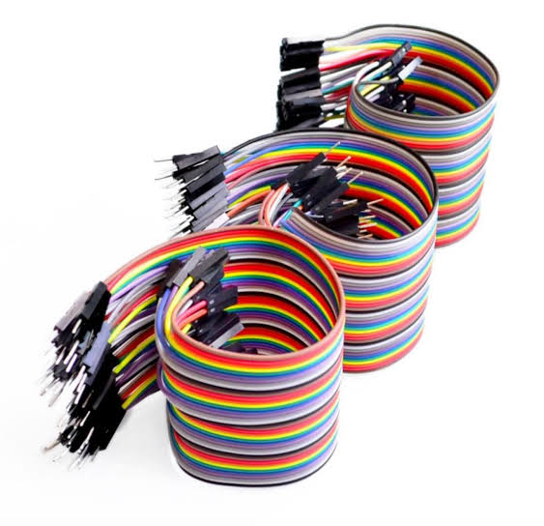
STEPS FOR AIR QUALITY MONITORING
Set up your Hardware:
Connect sir quality sensor in your Raspberry pi or Arduino using jumper wires as per the sensor’s datasheet

Slide 5
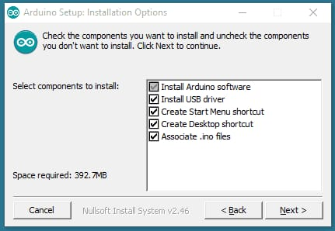
2.Install Necessary software:
Install the required libraries and software on your Raspberry pi or Arduino to interface with the sensor.

Slide 6
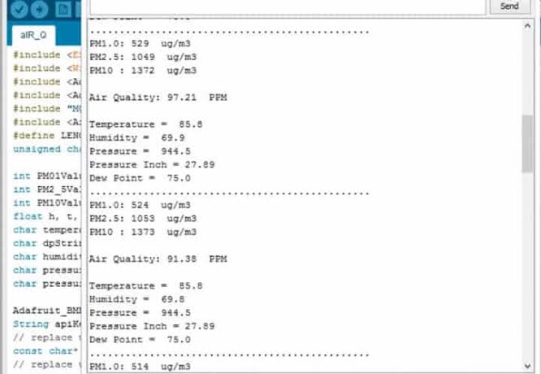
3. Collect Data:
Write a simple code to read data from the sensor at regular intervals(e.g. every minute).

Slide 7
4. Data storage:
Store the data locally on your device or send it to a cloud service example for Google e.g. Thing Speak for remote access.
5. Data visualization:
Create a basic web interface or use a service like Grafana to visualization in the air quality data.

Slide 8
6. Quality Assurance:
Analyse collected data to identify Analyse potential sources of pollution.
7. Reporting and Communication:
Prepare reports and visualizations of air quality data for dissemination to relevant stakeholders, including the public, local authorities, and environmental agencies.

Slide 9
CONNECTION DETAILS
Power Connection(VCC and GND):
The VCC pin provides 5V power to the sensor, and the GND pin is for ground connection, creating a complete circuit.
Connect the VCC pin of the MQ-135 sensor to the 5V pin on the Arduino.
Connect the GND pin of the MQ-135 sensor to one of the GND pin on the Arduino.

Slide 10
Analog Output(AOUT):
The MQ-135 sensor outputs an analogy voltage that corresponds to the air quality measurement. You connect this pin to one of the Arduino’s analogy pins to read this voltage.
Connect the AOUT pin of the MQ-135 to any analogy pin on the Arduino( e.g.AO)
Heater Coil(HOUT):
The sensor contains a heater coil that needs to be powered for the sensor to work correctly.
Connecting the HOUT pin to a digital pin on the Arduino allows you to control the heating element.
You can turn it on and off as needed to conserve energy.

Slide 11
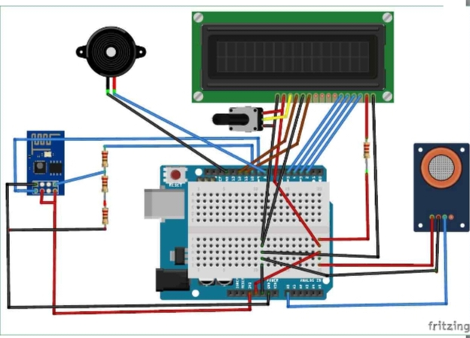
Load Resistor(RL):
The load resistor(RL) is essential for accurate readings. It forms a voltage divider circuit with the sensor’s internal resistor. A 10k ohm resistor is commonly used for RL.
The MQ-135 sensor requires a load resistor(RL)between the AOUT and GND pins. Use a resistor around 10k ohms.
Connect one end of the resistor to AOUT and the other end to GND.

Slide 12
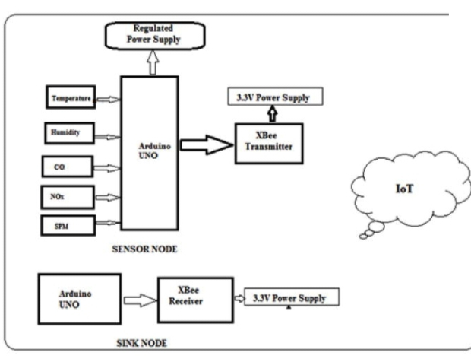
Code and Operation:
Arduino code is read data from the MQ-135 sensor.
Read the analog voltage from the AOUT pin and use it to calculate air quality values for example air quality index or ppm values for specific gases like CO2 or NH3.

Slide 13
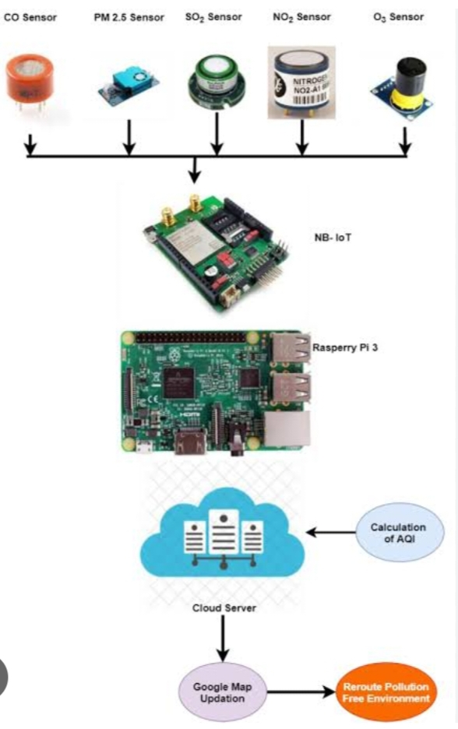
The code should also include control logic for the heater coil(HOUT) to warm up the sensor for accurate readings.

Slide 14
CODINGS:
int AOUT_PIN=AO;
int HEATER_PIN=2;
int sensor Value;
Void setup()
{
pin Mode (AOUT_PIN, INPUT);
pin Mode (HEATER_PIN, OUTPUT);
digital Write (HEATER_PIN, HIGH);
Serial. Begin(9600);
}

Slide 15
Void loop()
{
sensor Value = analogue(AOUT_PIN);
analogue(sensor Value);
delay(1000);
}

